Slide 1
Comprehension Skills and Strategies Module I: Making Predictions
Parent, Community and Student Services

Slide 2
DISTRICT GOALS
1. 100 percent graduation
2. Proficiency for all
3. 100 percent attendance
4. Parent and community engagement
5. School safety

Slide 3
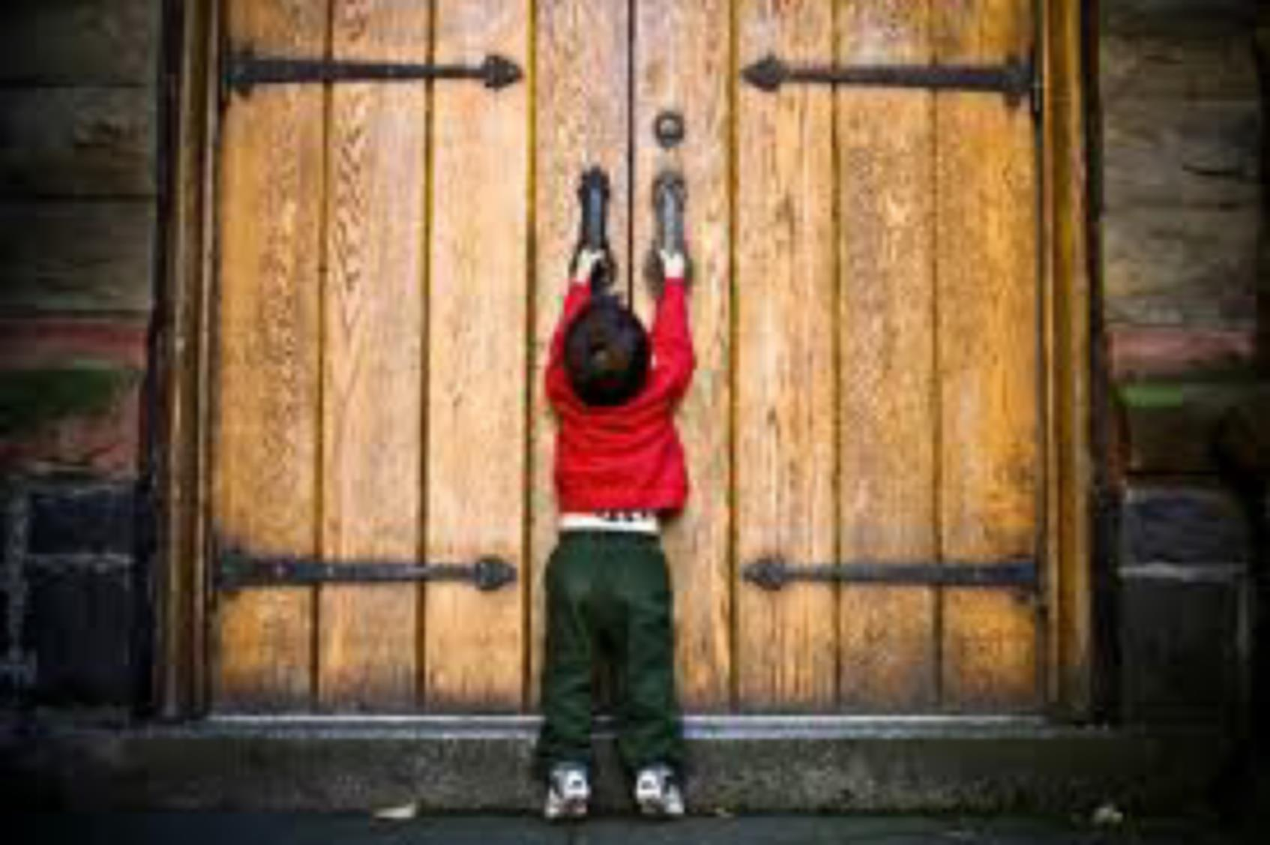
Reading is the to learning!

Slide 4
Something Memorable…

Slide 5
Reading Comprehension is the ability to read text, process it and understand its meaning.

Slide 6
Author’s Purpose
Making Predictions
Drawing Inferences
Comparing & Contrasting
Making Connections
Cause and Effect
Main Idea and Details
Visualize
Summarize

Slide 7
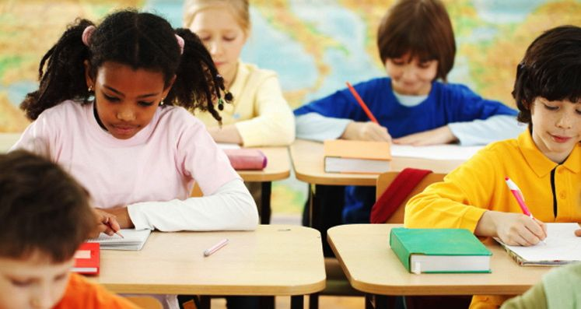

Slide 8
Making Predictions

Slide 9
Objectives
To increase our understanding of the reading comprehension strategy making predictions
To use sentence frames and graphic organizers to support student use of this strategy
To participate in learning activities in order to support learning at home

Slide 10
Vocabulary
predict
confirm
think
verify
revise
foresee
expect

Slide 11
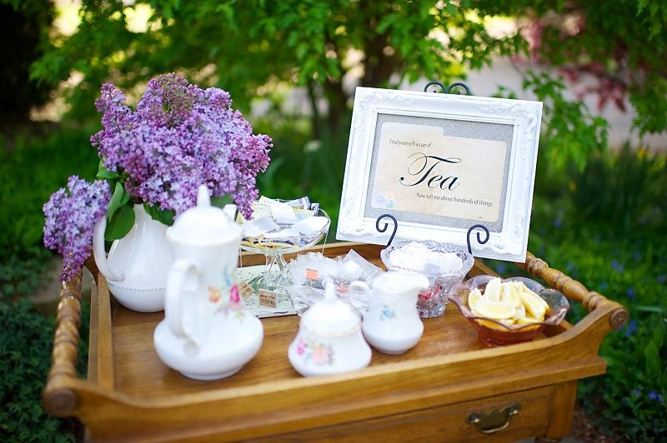
Tea Party

Slide 12
Making Predictions
A strategy in which readers use information from the text they are reading and their personal experiences to anticipate what they are about to read.

Slide 13
Making Predictions
Why?
Anticipation and prediction are key characteristics of effective reading
Promotes the use of prior knowledge
Improves the ability to draw inferences
Ongoing process that actively engages the reader
Improves retention

Slide 14
Making Predictions
How?
Use title, illustrations and text features to make predictions
Focus on the text at hand
Constantly think ahead
Refine, revise, and verify predictions as you obtain additional information while reading
Repeat the process and make new predictions

Slide 15
Making Predictions
Let’s Practice!

Slide 16
Graphic Organizer
First
Then
My prediction is…
Was your prediction confirmed? _______
If not, what happened instead?___________________

Slide 17
Sentence Frames
I predict that __________ will happen because_____________.
At first I thought ___________, but now I expect ____________.
I foresee ___________ will__________ because_____________.
Since ____________, I can assume that __________ will ____________.
I wish to change my prediction to_______ because ________________.
My prediction was confirmed/verified when ____________________.
My prediction was refuted when _________________.
After analyzing the text features, I hypothesize that_______________.

Slide 18
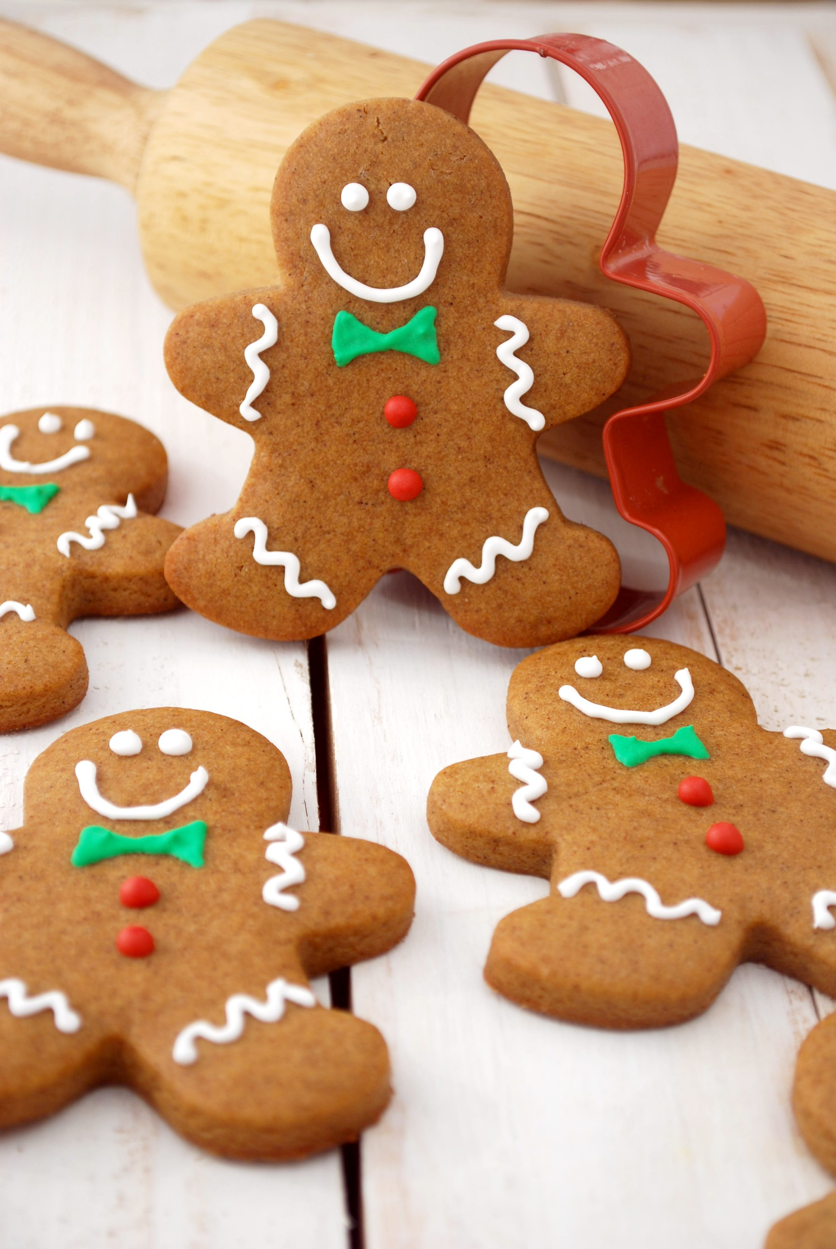
Making Predictions

Slide 19
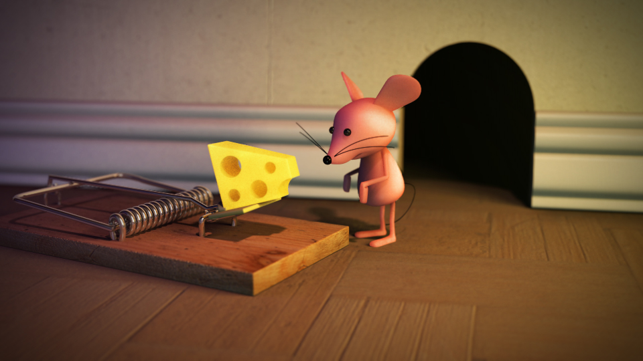
Making Predictions
“Mr. Nibbles”

Slide 20
Making Predictions
“Mr. Nibbles”
What event is most likely to occur next?
Mr. Nibbles is going to get caught in that mousetrap.
What evidence from the text and from your own experiences support your prediction?
I believe this because the device that Mr. Nibbles encounters is a mousetrap. He
is attempting to remove cheese from a mousetrap. This will probably cause him
to get caught by the mousetrap.

Slide 21
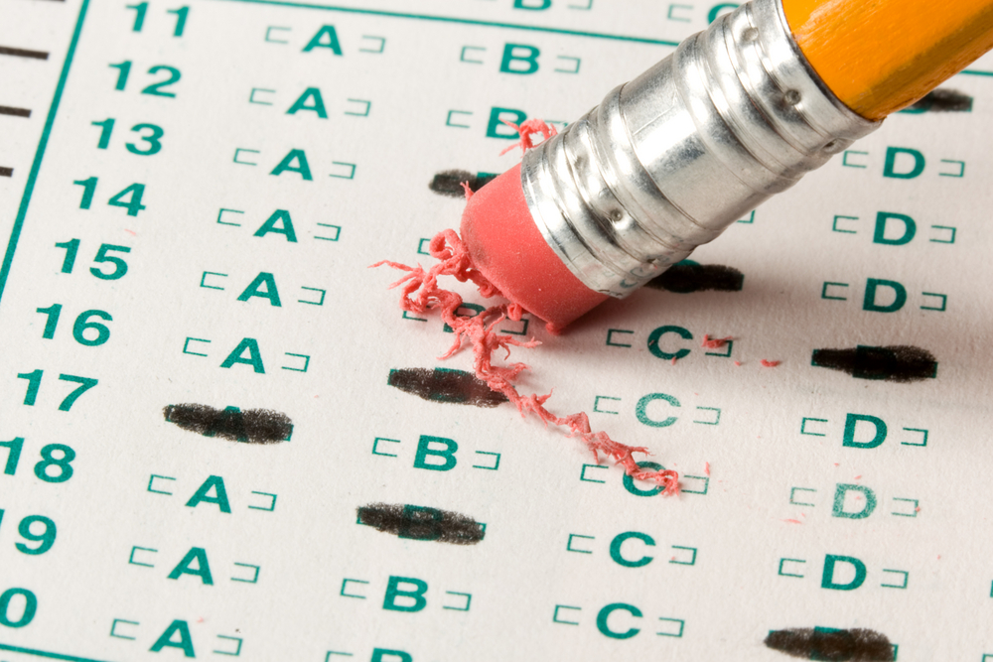
What are the benefits of using the strategy Making Predictions during reading?
A. Improves the ability to draw inferences
B. Improves retention
C. You can enjoy a future career with the Psychic Network.
D. A and B

Slide 22
Home Practice
PREDICTING VOCABULARY
Select 3-4 words from a book/poem/article that your child is going to read.
Ask your child to predict the definitions of the words based on word parts, root words, and prior knowledge.
Ask your child to write sentences that he/she might expect to see in the selection.
Ask your child to read and to evaluate his/her sentences.

Slide 23
Home Practice
TOUR OF A BOOK
Using a book, ask your child to make a list of the different text features that supply clues about the text such as: chapter titles, pictures, maps, table of contents, and book cover.
Based on this information, ask your child to make a prediction about what the text will be.

Slide 24
Home Practice
NEWS STORIES
Select a newspaper article.
Ask your child to cover the story with a piece of paper, showing only the headline.
Ask your child to read the headline aloud to make a prediction about the story and answer who, what, where, when, why, and how.
Ask your child to read the first paragraph of the story and discuss whether he/she can confirm or reject prediction.
Continue reading and stopping along the way to make predictions.

Slide 25
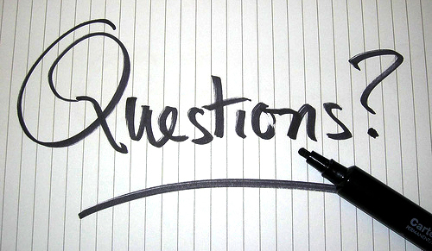

Slide 26
Objectives
To increase our understanding of the reading comprehension strategy making predictions
To use sentence frames and graphic organizers to support student use of this strategy
To participate in learning activities in order to support learning at home

Slide 28
families.lausd.net

